Slide 1

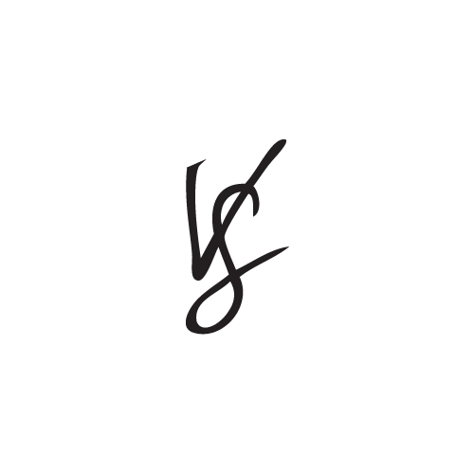


By Avinash Kustagi

Slide 2





Companies Overview
Darden Brand (Other Brands - Olive Garden, Longhorn Steakhouse & Other 5 )
1st Restaurant in 1968 in Orlando, Florida
Over 700 Restaurant in USA
Present in 11 Countries
60,000 Employees
Acquired by Golden Gate Capital for $ 2.1 BN in 2014
Bloomin Brands (Other Brands - Outback Steakhouse, Carrabas etc..)
BFG Acquired by in Bloomin Brands in 2001 (only 3 Restaurants)
Presently in 28 States with Over 200 Restaurants
Channels:
Notes:
The Engagement Rate is calculated by taking the total PTAT (people talking about this) and divide by the total number of likes. Our surveys has shown us that in order to reach success on Facebook you should have an engagement rate greater than 7%
People Talking About This (PTAT)

Slide 3

RL should avoid hashtags, increase Response rate and time & Ask more question to get engaged
Engagement Rate: 6.88% ( Sh’d be 7% and More)
Average Likes, Comments & Shares per post: 38,790
Variety in posts
Posts per Week: 2.73 ( featuring new items, promos, national holidays, celebrations)
Hashtags: Using (Hashtags are not doing good)
Response Rate: Poor (30%).
Response Time: 6Hr
Most User Requests: 6pm – 8pm (CDT) and 12pm – 2pm (CDT) and the most common days are Tuesdays.
Engagement Rate: 3.19% (Vary Bad)
Average Likes, Comments & Shares per post: 4,926
Variety in posts
Posts per Week: 1.76 ( featuring new items, promos, national holidays, celebrations)
Hashtags: Not using
Response Rate: Poor (60%)
Response Time: 39Hr
Most User Request: Between 9am – 11am (CDT) and the most common days are Fridays.
Notes:
The Engagement Rate is calculated by taking the total PTAT (people talking about this) and divide by the total number of likes. Our surveys has shown us that in order to reach success on Facebook you should have an engagement rate greater than 7%
People Talking About This (PTAT)
Likealyzer

Slide 4
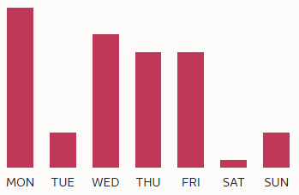
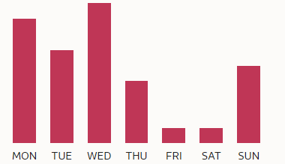

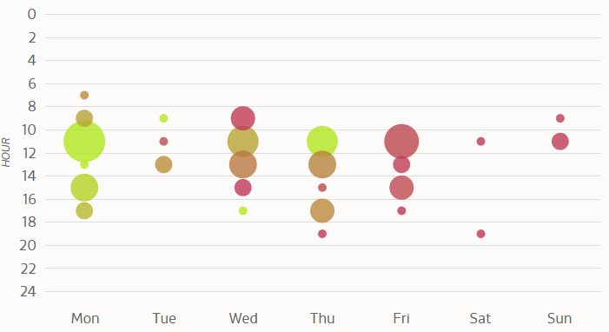
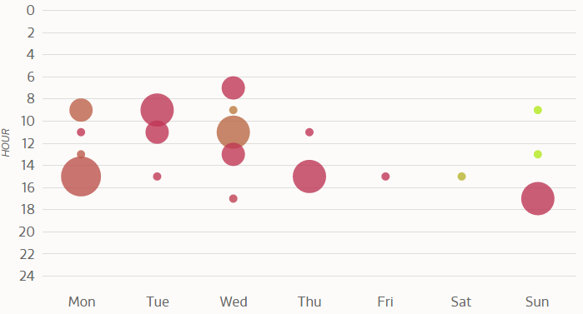
Frequency and Time of posts for these Brands From Feb’2016 to Jun’2016
NOTE: Brighter the Green Higher the Response & BIGGER the dot more number of posts
Publishes between 9am– 1pm (CDT)
Ideal Time : 10am – 1pm (CDT)
Ideal Day: Monday, Wednesday and Thursday
Publishes between 8am – 12pm and 2pm – 4pm (CDT)
Ideal Time : 9am – 1pm (CDT)
Ideal Day: Sunday’s

Slide 5
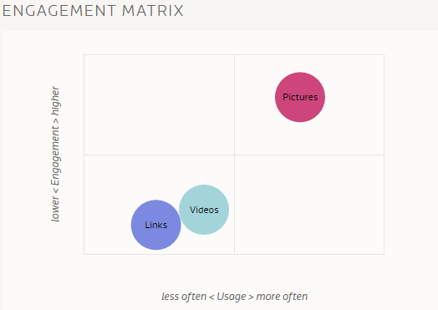
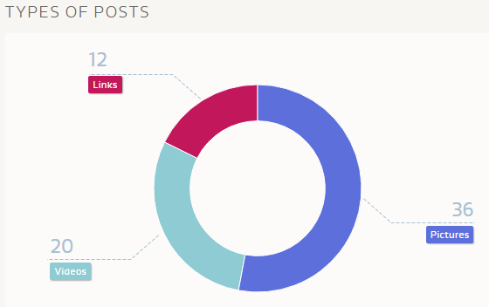
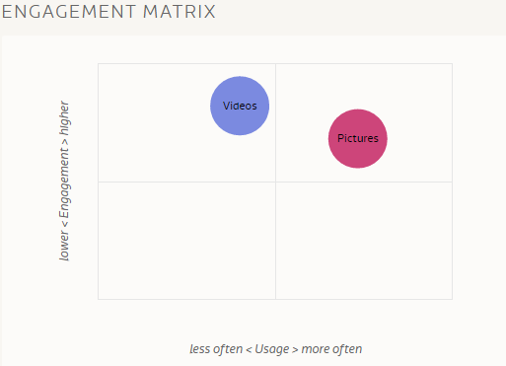
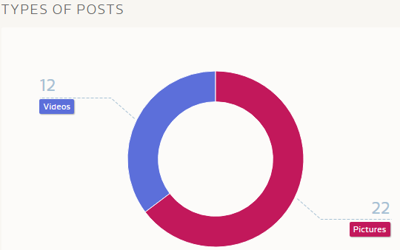
RL should avoid links & focus more on photos ; BFG positioned very well in terms of variety compared to RL
Photos are the best (Avoid links)

Slide 6
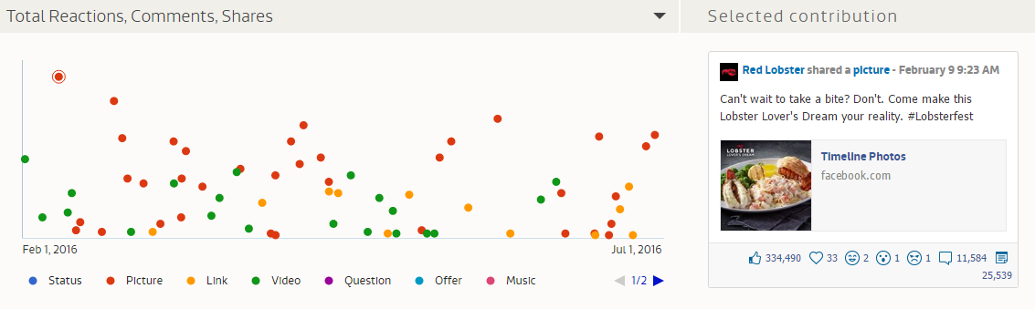

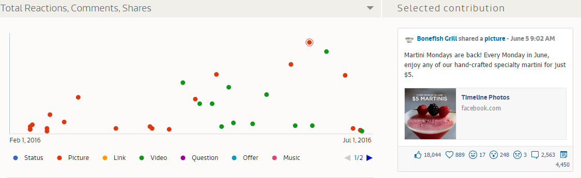
Response overview From Feb’2016 to June’2016 – Huge decrease in Likes & response
( Watch out for the changes over the time) – Avoid links , Hashtags & increase photos and Videos
VIDEO
LINKS
VIDEO

Slide 7

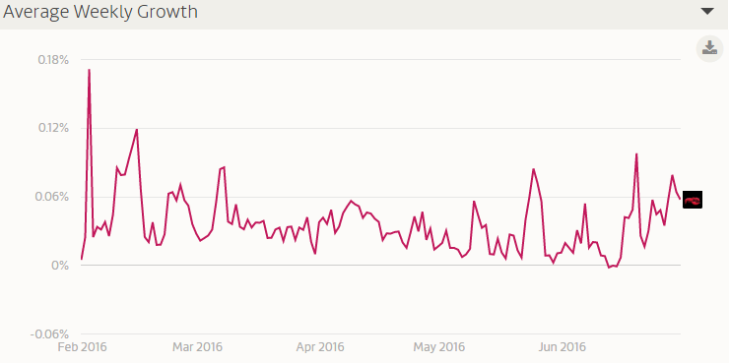
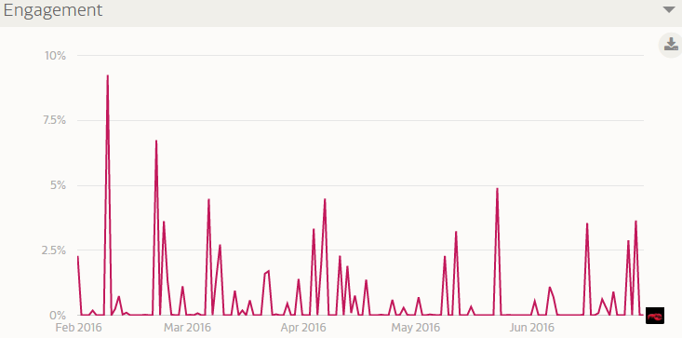
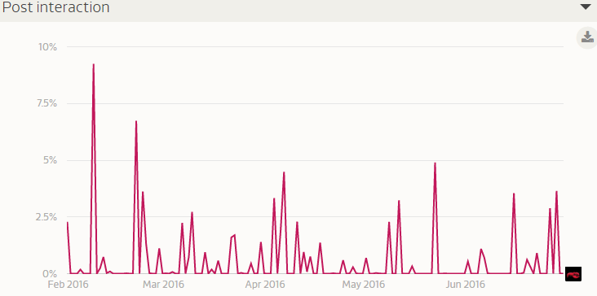
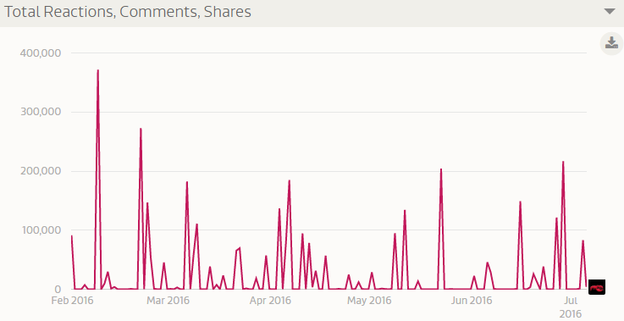
Insights from (Feb2016 to June’2016) – RL is doing bad with lesser response over the time, It has to Increase the Engagement and Post interaction to be competitive enough other compare to BFG or others
LIKES
SHARES
COMMENTS
LOVE
ANGER
HAHA

Slide 8

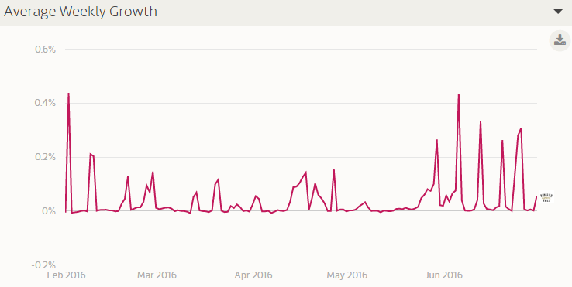
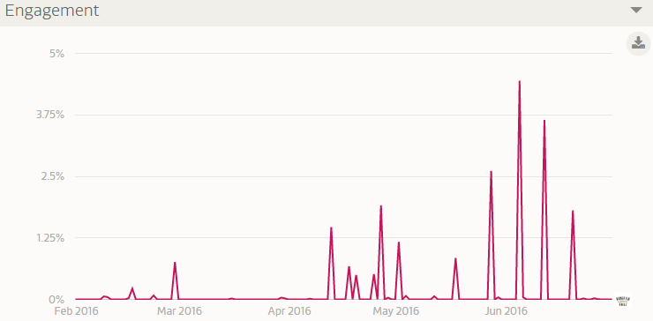

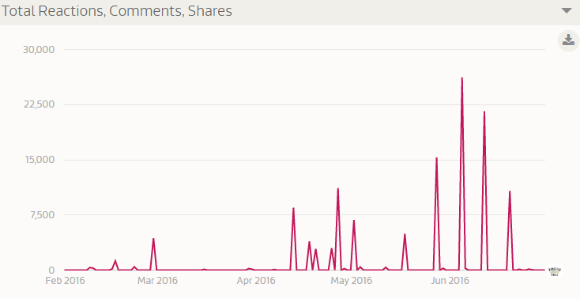
Insights from (Feb2016 to June’2016) – Keep consistent with engagement and interactions
LIKES
SHARES
COMMENTS
LOVE
SAD
HAHA
ANGRE

Slide 9
Overview of Seafood Chains in Instagram From Feb’2016 to Jun’2016
Profile Performance Index – 14%(Feb);17% (For June)
Follower – 107K
Following – 39
Follower/Following ratio – 2.7K
No of Post – 48 Post ( Since Feb 1st)
Likes & Comments – 50K (Since Feb)
Growth rate – 11% in 1 Month ; 52 % in 4 Months
Engagement – 0.39% (Since Feb) 0.43% (For June)
Post Interaction – 1.3% (Since Feb)
Posts per day – 0.3 (Since Feb) 0.3 (For June)
(Not actively using with all the new items, promos, national holidays, celebrations)
Profile Performance Index – NA(Feb); 13% (For June)
Follower – 16K
Following – 184
Follower/Following ratio – 90
No of Post – 59 Post ( Since Feb 1st)
Likes & Comments – (14K Feb)
Growth rate – 1.1%
Engagement – 0.12% ( Since Feb 1st ) 0.59% (For June)
Post Interaction – 1.2% (Since Feb)
Posts per day – 0.4( Since Feb), 0.4 (For June)
(Not actively using with all the new items, promos, national holidays, celebrations)
Notes:
Profile Performance Index- The PPI shows how many interactions happen on a profile, how engaged the followers are and how fast a profile is growing. The higher it is, the better. A lot of engagement and healthy growth show liveliness and a lot of engagement, which depend on each other. This indicator shows how active an account really is and how strong its ties to the community are. This KPI is especially important to gauge the real „image“ of a profile. A high amount of followers or posts per day aren’t always indicators for a high quality account.

Slide 10
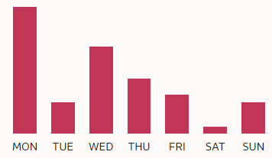
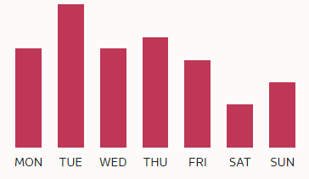
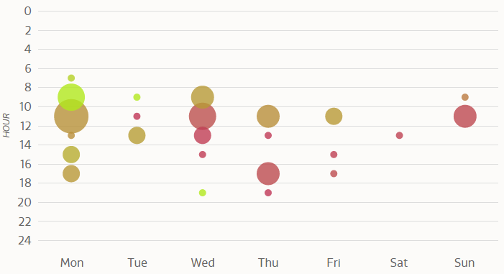
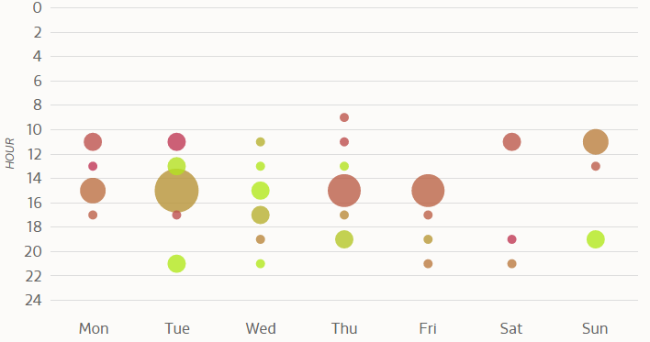
Frequency and Time of posts for these Brands
NOTE: Brighter the Green Higher the Response & BIGGER the dot more number of posts
Publishes between 9am – 1pm (CDT)
Ideal Time : 9am – 11am (CDT)
Ideal Day: Monday, & Tuesday
Publishes between 2pm – 4pm (CDT)
Ideal Time : 12pm – 2pm (CDT)
Ideal Days: Tuesday & Wednesday

Slide 11
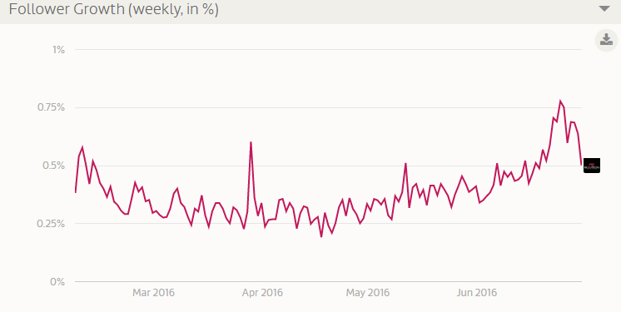
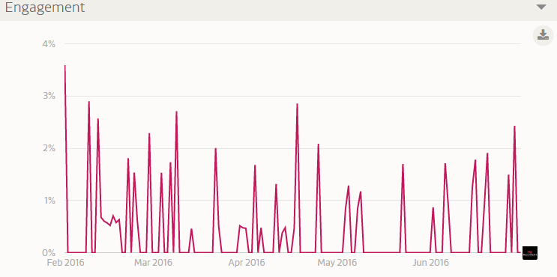
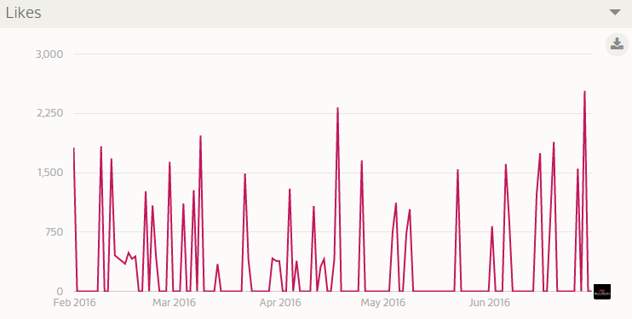
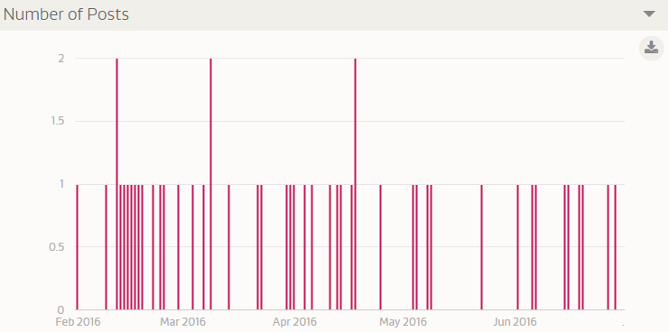
Red Lobster Insights from (Feb2016 to June’2016) Increase the engagement & Interactions; BFG has turned active recently and they are getting better comped to RL ( Positive trends)

Slide 12

Overview
Profile Performance Index – 26%(Since Feb)
Follower – 250K
Following – 212
Follower/Following ratio – 1.17K
No of Tweets – 17.6K (Since 2007)
Growth rate – 0.24% Since Feb
Engagement – 0.20% (Since Feb)
Tweets per day – 54 (Since Feb) ( Using this has major communication channels to reach their fans, post also featuring new items, promos, national holidays, celebrations, retweeting)
Profile Performance Index – 26%(Since Feb)
Follower – 28K
Following – 1144
Follower/Following ratio – 24.5
No of Tweets – 7.7K (Since 2009)
Growth rate – 0.13% Since Feb
Engagement – 0.062% (Since Feb)
Tweets per day – 3.4 (Since Feb) ( not much interactive with follower compared to RL, looks like FB is their big bet, slowly they are focusing on Twitter as well )

Slide 13
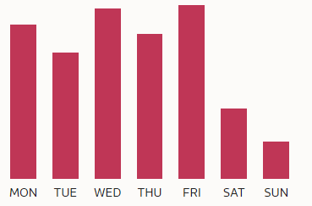
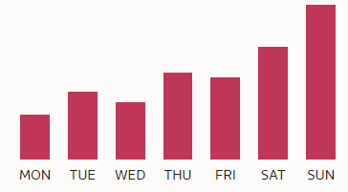
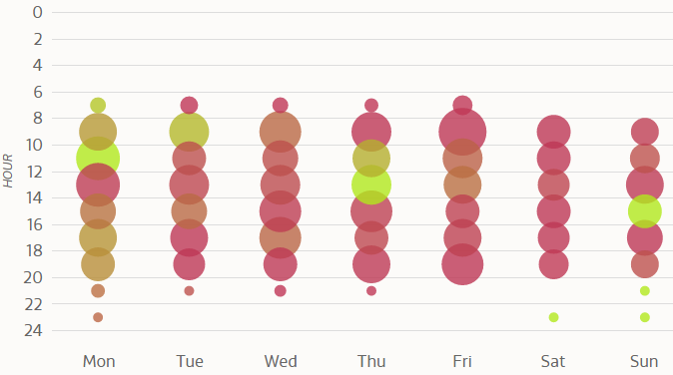
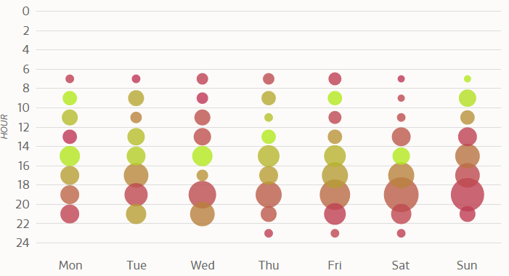
Overall the Bonefish grill looks more successful, with better response than RL
NOTE: Brighter the Green Higher the Response & BIGGER the dot more number of posts
Publishes between 8am – 8pm (CDT) – 54 /day (Huge) Reduce the No. of Tweets
Ideal Time : 9am– 2pm (CDT)
Ideal Day: Monday, Thursday & Sunday
Publishes between 4pm – 9pm (CDT)
Ideal Time : 8am – 10am (CDT) & 2pm – 5pm (CDT)
Ideal Days: Week days

Slide 14
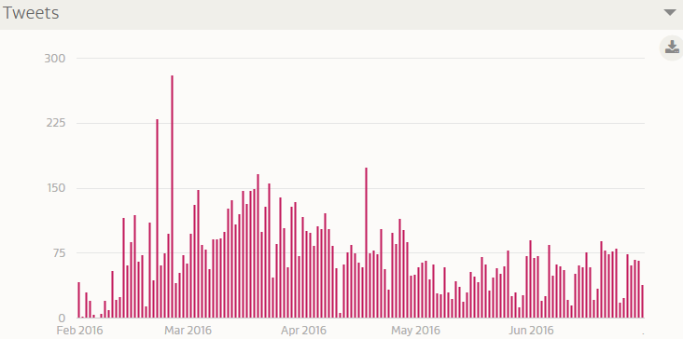
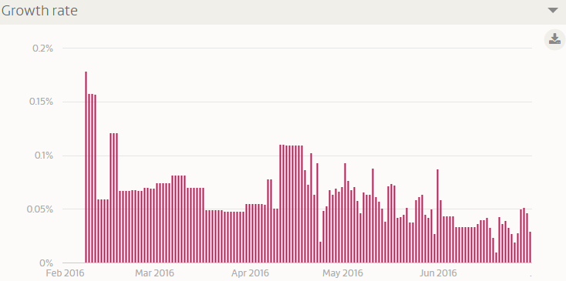
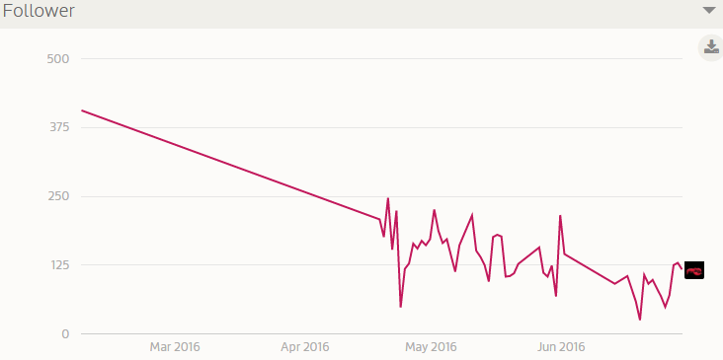
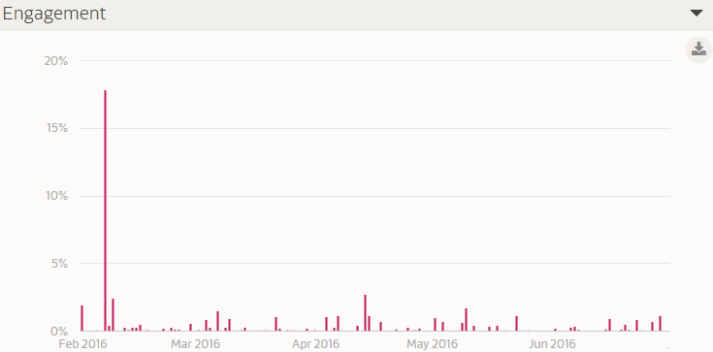
Insights from (Feb2016 to June’2016) – Reduce the No. tweets, increase the engagement & Interactions; BFG has turned active recently and they are getting better comped to RL ( Positive trends)
Tweet Interactions
Retweets per tweet
Retweets and Like
No of Interactions
Followers

Slide 15
SWOT & Channel Effectiveness
Strength- Well know brand
Weakness – Decreasing engagement & Overall response by audience
Opportunity- Increasing Social media Growth
Threats – few bad comments & Many smaller brands
Strength - Relatively New with Positive wave with gradual increase in share
Weakness- No consistency in Social Media reach
Opportunity - Good mix & Good attention
Threats – smaller brands
Facebook looks like more preferred channel for both the brands with maximum audience reach with better engagement compared to other two media channels
Notes:
The Engagement Rate is calculated by taking the total PTAT (people talking about this) and divide by the total number of likes. Our surveys has shown us that in order to reach success on Facebook you should have an engagement rate greater than 7%
People Talking About This (PTAT)
Likealyzer
Seafood Consumption: http://www.greenfacts.org/en/fisheries/figtableboxes/figure-44.htm

Slide 16



Slide 17
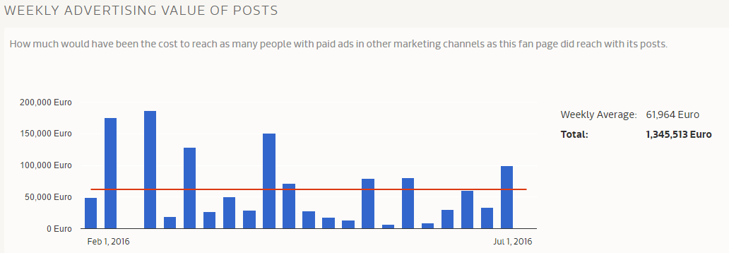
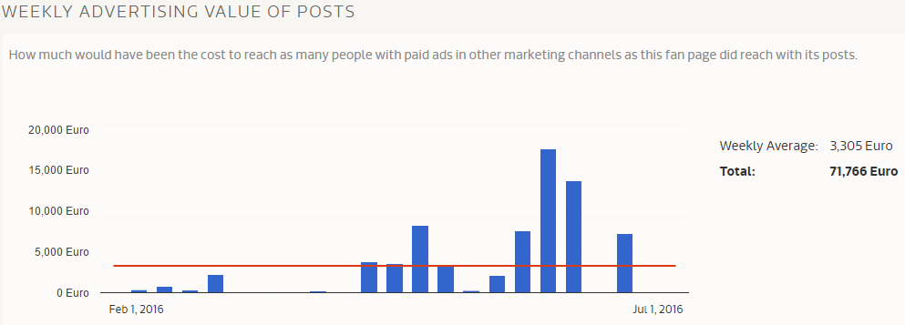
Advertising Value

Slide 18

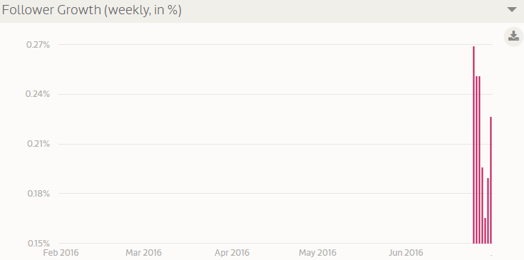
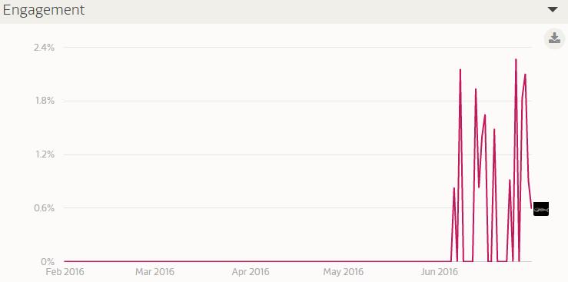
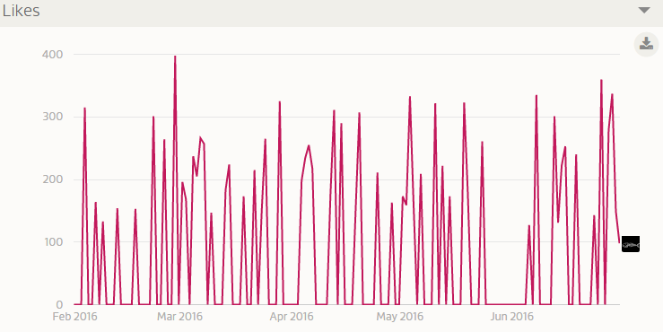
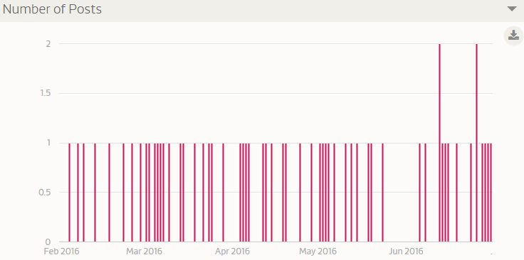
Bonefish Grill Insights from (Feb2016 to June’2016) – Keep consistent with Instagram campaign

Slide 19
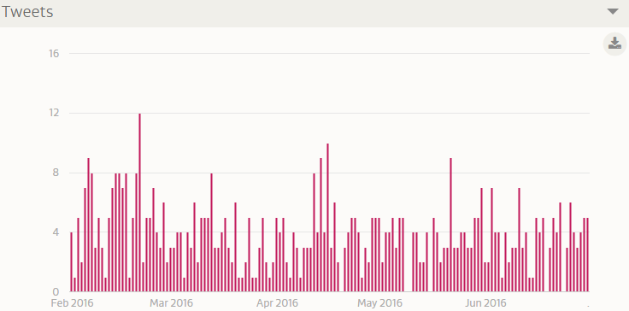
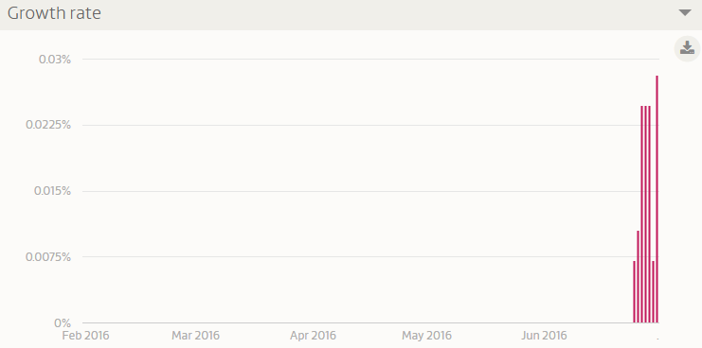
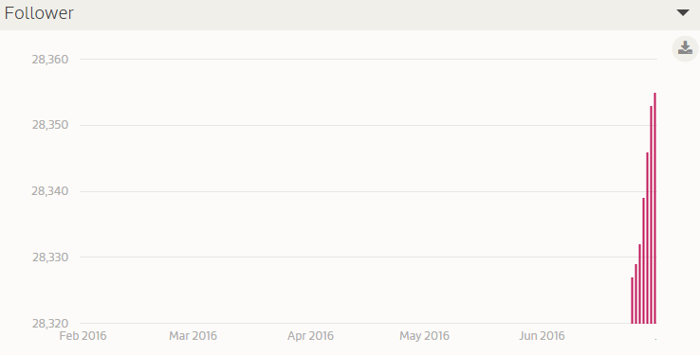
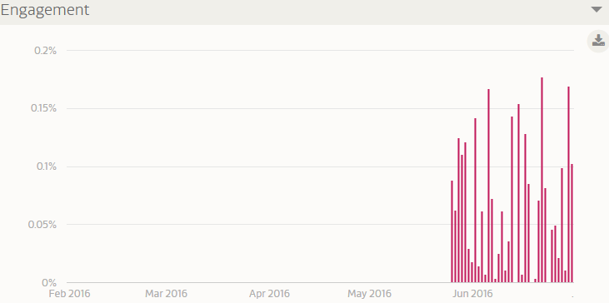
Bonefish Grill Twitter Insights from (Feb2016 to June’2016) – Keep consistent with twitter campaign
Tweet Interactions
Retweets per tweet
Retweets and Like
No of Interactions
Followers

Slide 20
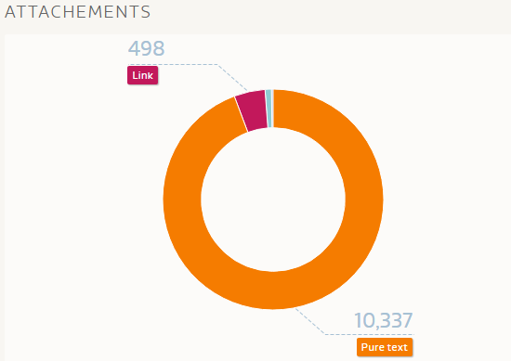
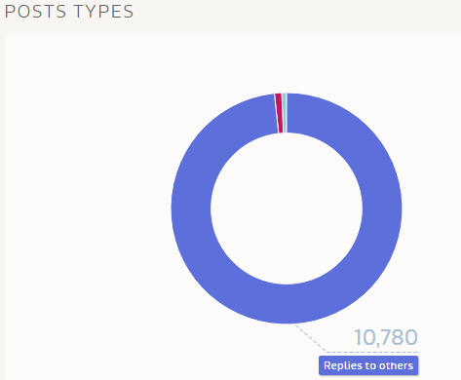
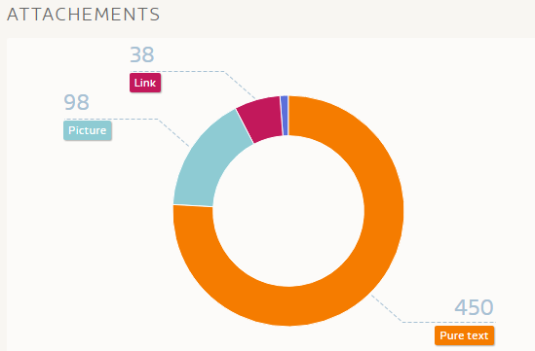
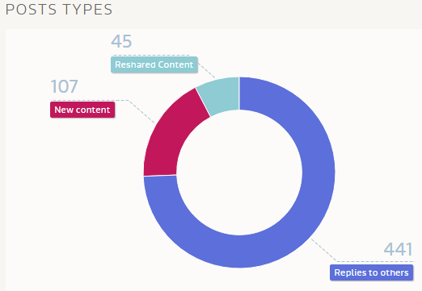
Red Lobster to be focused on Variety, Increase Re-shares & Reduce the No of Tweets

